Slide 1
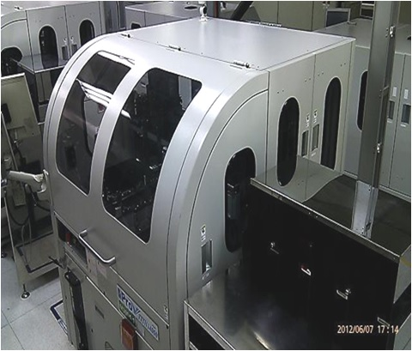
Manufacture | Prov | Model | TTTH14000
Detail | This is Sanwa tester handler, which has a function for tray to tray hanlder, that transfer device to different tray.
Photo

